Slide 1


12
Handling Exceptions
C# Programming: From Problem Analysis to Program Design
3rd Edition

Slide 2
Chapter Outline
Exception
Exception Handling
Raising an Exception
Custom Exception

Slide 3
1. Exception
Exception – indicates problem occurs during runtime
Example
input data is wrong type
when program tries to convert the data (e.g. using Convert.ToInt32() to convert string input to integer value), an exception occurs

Slide 4
Exception Example1
using System;
public class FormatExceptionExample
{
public static void Main()
{
Console.Write("Enter an integer: ");
string input = Console.ReadLine();
int number = Convert.ToInt32(input);
Console.WriteLine("Number is: {0}\n",
number);
}
}

Slide 5
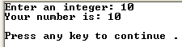
Exception Example1
Case 1 – valid input

Slide 6
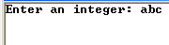
Exception Example1
Case 2 – invalid input

Slide 7
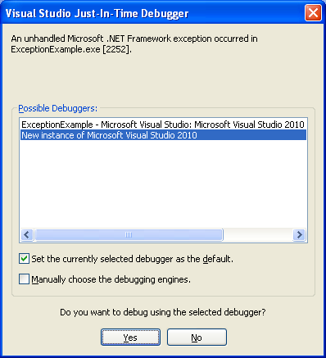
Exceptions
Case 2
Click ‘Yes’ button

Slide 8
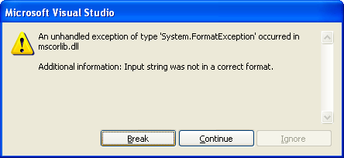
Exception Example1
Case 2

Slide 9
Exception Example1
Case 2 – The exception details

Slide 10
Exception Example2
using System;
public class DivideByZeroExceptionExample
{
public static void Main()
{
Console.Write("Enter numerator: ");
int n1 = Convert.ToInt32(Console.ReadLine());
Console.Write("Enter denominator: ");
int n2 = Convert.ToInt32(Console.ReadLine());
int result = n1 / n2;
Console.WriteLine("Result: {0}\n", result);
}
}

Slide 11
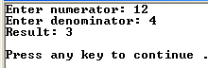
Exception Example2
Case 1 – valid input

Slide 12
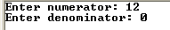
Exception Example2
Case 2 – invalid input

Slide 13
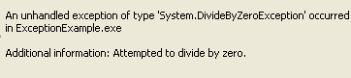
Exception Example2
Case 2 – The exception details

Slide 14
2. Exception-Handling
Exception-handling is a way to handle exceptions
Exception handling is implemented using try-catch-finally blocks

Slide 15
Try-Catch-Finally Blocks
Code that may create a problem is placed in the try block
Code to deal with the problem is placed in catch blocks
this code is called the exception handler
Code to be executed whether an exception occurs or not is placed in the finally block

Slide 16
Try-Catch-Finally Blocks
A try block must be associated with at least 1 catch block and/or a finally block
A finally block is optional
A catch block must have an associated try block
A finally block must have an associated try block

Slide 17
Try-Catch Example1
using System;
public class TryCatchExample1
{
public static void Main()
{
try // try block
{
Console.Write("Enter an integer: ");
string input = Console.ReadLine();
int number = Convert.ToInt32(input);
Console.WriteLine("Number is: {0}\n",
number);
}

Slide 18

Try-Catch Example1
catch // catch block
{
Console.WriteLine("Invalid input");
}
// no finally block
}
}

Slide 19
Try-Catch Example2
using System;
public class TryCatchExample2
{
public static void Main()
{
try // try block
{
Console.Write("Enter numerator: ");
int n1 = Convert.ToInt32(Console.ReadLine());
Console.Write("Enter denominator: ");
int n2 = Convert.ToInt32(Console.ReadLine());
int result = n1 / n2;
Console.WriteLine("Result: {0}\n", result);
}

Slide 20
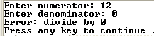
Try-Catch Example2
catch // catch block
{
Console.WriteLine("Error: divide by 0");
}
// no finally block
}
}

Slide 21
Exception Object
When an exception is raised, an object of a certain exception class is created
Example Classes:
FormatException
DivideByZeroException
ArgumentOutOfRangeException

Slide 22
Exception Object
These classes are sub classes of System.SystemException
Example: Inheritance hierarchy
Object
Exception
SystemException
ArgumentException
ArgumentOutOfRangeException
ArithmeticException
DivideByZeroException
FormatException

Slide 23
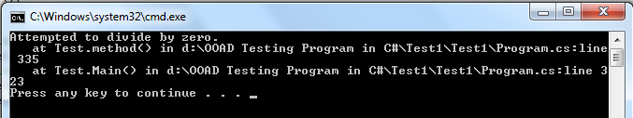
Exception Object
SystemException class has:
Message property which returns a string describing the exception
StackTrace property which returns a string that contains the called trace of methods

Slide 24
Catch Blocks
A catch block can be used to catch and handle a specific type of exception
Example:
catch (FormatException)
{
Console.WriteLine("Invalid input");
}
A try block may be associated with any number of catch blocks

Slide 25
Try-Catch Example3
using System;
public class TryCatchBlockExample3
{
public static void Main()
{
try // try block
{
Console.Write("Enter numerator: ");
int n1 = Convert.ToInt32(Console.ReadLine());
Console.Write("Enter denominator: ");
int n2 = Convert.ToInt32(Console.ReadLine());
int result = n1 / n2;
Console.WriteLine("Result: {0}\n", result);
}

Slide 26
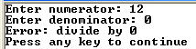
Try-Catch Example3
catch (FormatException)
{
Console.WriteLine("Invalid input");
}
catch (DivideByZeroException)
{
Console.WriteLine("Error: divide by 0");
}
}
}

Slide 27
Catch Blocks
An object name may be specified as well in the catch clause in order to access the Message or StackTrace properties
Example:
catch (FormatException exception)
{
Console.WriteLine(exception.Message);
}
catch clause

Slide 28
Try-Catch Example4
using System;
public class TryCatchBlockExample4
{
public static void Main()
{
try // try block
{
Console.Write("Enter numerator: ");
int n1 = Convert.ToInt32(Console.ReadLine());
Console.Write("Enter denominator: ");
int n2 = Convert.ToInt32(Console.ReadLine());
int result = n1 / n2;
Console.WriteLine("Result: {0}\n", result);
}

Slide 29
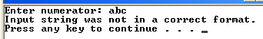
Try-Catch Example4
catch (FormatException exception)
{
Console.WriteLine(exception.Message);
//Console.WriteLine(exception.StackTrace);
}
catch (DivideByZeroException exception)
{
Console.WriteLine(exception.Message);
//Console.WriteLine(exception.StackTrace);
}
}
}

Slide 30
Finally Block Example1
try // try block
{
Console.Write("Enter an integer: ");
. . .
}
catch (FormatException) // catch block
{
Console.WriteLine("Invalid input");
}
finally // finally block
{
Console.WriteLine("Execution ended");
}

Slide 31
Finally Block Example2
try // try block
{
Console.Write("Enter an integer: ");
. . .
}
// no catch block
finally // finally block
{
Console.WriteLine("Execution ended");
}

Slide 32
3. Raising an Exception
Suppose our class has a method that may have a problem in certain situations
If no recovery is possible, the method can indicate an error by raising an exception
Raising an exception is also called throwing an exception
Throwing an exception involves an exception object

Slide 33
Raising an Exception Example
using System; // for ArgumentOutOfRangeException
public class Account
{
private decimal balance = 0.0M;
public decimal Balance
{
get { return balance; }
set
{
if (value >= 0.0M)
balance = value;
else // throwing an exception
throw new ArgumentOutOfRangeException();
}
}
no arguments

Slide 34
Raising an Exception Example
public Account(decimal initialBalance)
{
Balance = initialBalance;
}
public void Withdraw(decimal amount)
{
if (amount <= Balance)
Balance = Balance - amount;
else // throwing an exception
throw new ArgumentOutOfRangeException
("amount",
"Amount cannot be greater than balance");
}
}
2 arguments

Slide 35
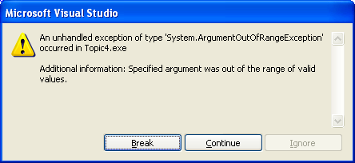
Raising an Exception Example
using System;
public class AccountTest1
{
public static void Main()
{
Account account = new Account(-5.0M);
// ArgumentOutOfRangeException is thrown here
}
}

Slide 36
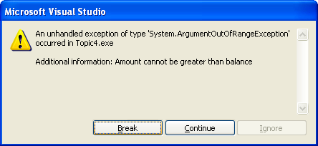
Raising an Exception Example
using System;
public class AccountTest2
{
public static void Main()
{
Account account = new Account(500.0M);
account.Withdraw(1000.0M);
// ArgumentOutOfRangeException is thrown here
}
}

Slide 37
Uncaught Exception
An uncaught exception (or unhandled exception) is :
an exception for which there is no try-catch blocks or
an exception for which no catch block matches the exception raised

Slide 38
Uncaught Exception
What happens if an uncaught exception occurs?
For example, suppose method Main calls method A and method A calls method B
When an exception occurs during the execution of method B, and method B does not catch the exception, method B terminates

Slide 39
Uncaught Exception
Program execution returns to method A
If method A does not catch the exception, method A terminates
Then program execution returns to Main
If Main does not catch the exception, Main terminates

Slide 40
4. Custom Exception
We can define new exception classes as sub classes of those in the .NET Framework library
Normally these custom exception classes should be derived from ApplicationException class in the System namespace

Slide 41
Custom Exception Example
public class NegativeNumberException :
System.ApplicationException
{
public NegativeNumberException
(string exceptionMessage)
: base (exceptionMessage)
{
// Empty body
}
}

Slide 42
Custom Exception Example
public class Account
{
private decimal balance = 0.0M;
public decimal Balance
{
get { return balance; }
set
{
if (value >= 0.0M)
balance = value;
else // throwing an exception
throw new NegativeNumberException
("Negative balance not allowed");
}
}

Slide 43
Custom Exception Example
public Account(decimal initialBalance)
{
Balance = initialBalance;
}
public void Withdraw(decimal amount)
{
if (amount < 0.0M)
throw new NegativeNumberException
("Negative amount not allowed");
else

Slide 44
Custom Exception Example
{
if (amount <= Balance)
Balance = Balance - amount;
else
throw new ArgumentOutOfRangeException
("amount",
"Amount cannot be greater than balance");
}
}
}

Slide 45
Custom Exception Example
public class AccountTest3
{
public static void Main()
{
decimal balance, amount;
try
{
// input balance and amount values here
Account account = new Account(balance);
account.Withdraw(amount);
}

Slide 46
Custom Exception Example
catch (NegativeNumberException ex)
{
Console.WriteLine(ex.Message);
}
catch (ArgumentOutOfRangeException ex)
{
Console.WriteLine(ex.Message);
}
catch // general catch block
{
Console.WriteLine("Some other error");
}
}
}

Slide 47
Multiple Catch Blocks
With multiple catch blocks, start with most specialized to most general class
Example:
catch (ArgumentOutOfRangeException ex)
{ . . . }
catch (ArgumentException ex)
{ . . . }
catch (Exception)
{ . . . }

Slide 48
public static void Main()
{
int a = 5, b = 1;
try
{
Console.WriteLine("The answer is ");
Console.WriteLine(a/b);
Console.WriteLine("Welcome to C#");
}
catch
{
Console.WriteLine("Integer division error");
}
finally
{
Console.WriteLine("The end");
}
}

Slide 49
Suppose that statement2 causes an exception in the following try-catch block: try{ statement1; statement2; statement3; } catch (Exception1 ex1) { } catch (Exception2 ex2) { } statement4; Answer the following questions:
Will statement3 be executed?
If the exception is not caught, will statement4 be executed?
If the exception is caught in the catch clause, will statement4 be executed?
If the exception is passed to the caller, will statement4 be executed?

